Slide 1
CS123 Wikipedia Data Project
By Julian McClellan, Bobby Adusumilli, and Andy Zhu

Slide 2
wikidata/wikistats (2.5TB Uncompressed)
Contains hourly Wikipedia article traffic statistics dataset covering 16 month period from October 01 2008 to Februrary 06, 2010.
Each log file is named with the date and time of collection and there is one file per hour:
pagecounts-20090430-230000.gz
en Barack_Obama 997 123091092
en Barack_Obama%27s_first_100_days 8 850127
en Barack_Obama,_Jr 1 144103
en Barack_Obama,_Sr. 37 938821
en Barack_Obama_%22HOPE%22_poster 4 81005
en Barack_Obama_%22Hope%22_poster 5 102081

Slide 3
wikidata/wikilinks (1.1G)
Links-simple-sorted.txt
from1: to11 to12 to13 ...
from2: to21 to22 to23 ...
To find the page title that corresponds to integer n, just look for the nth line in titles-sorted.txt

Slide 4
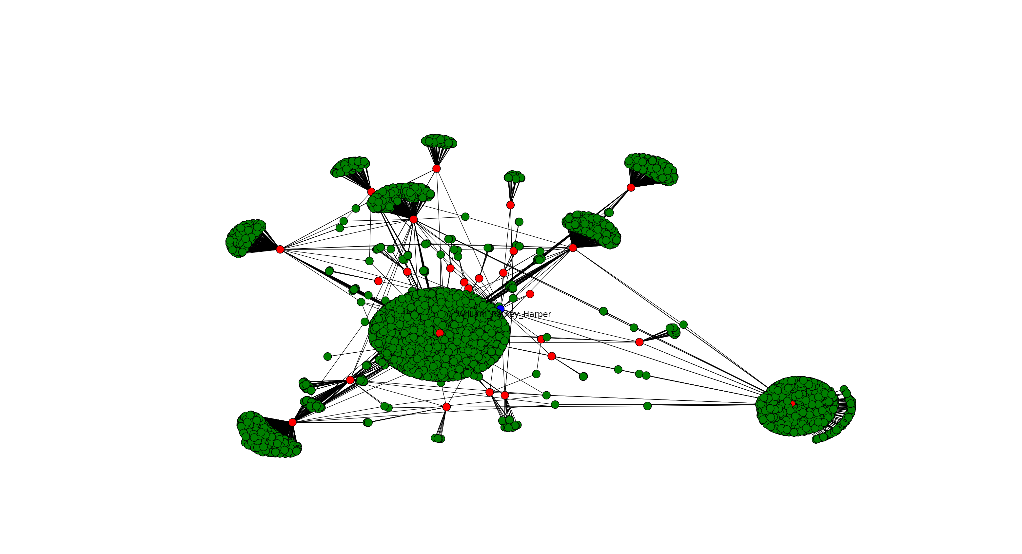
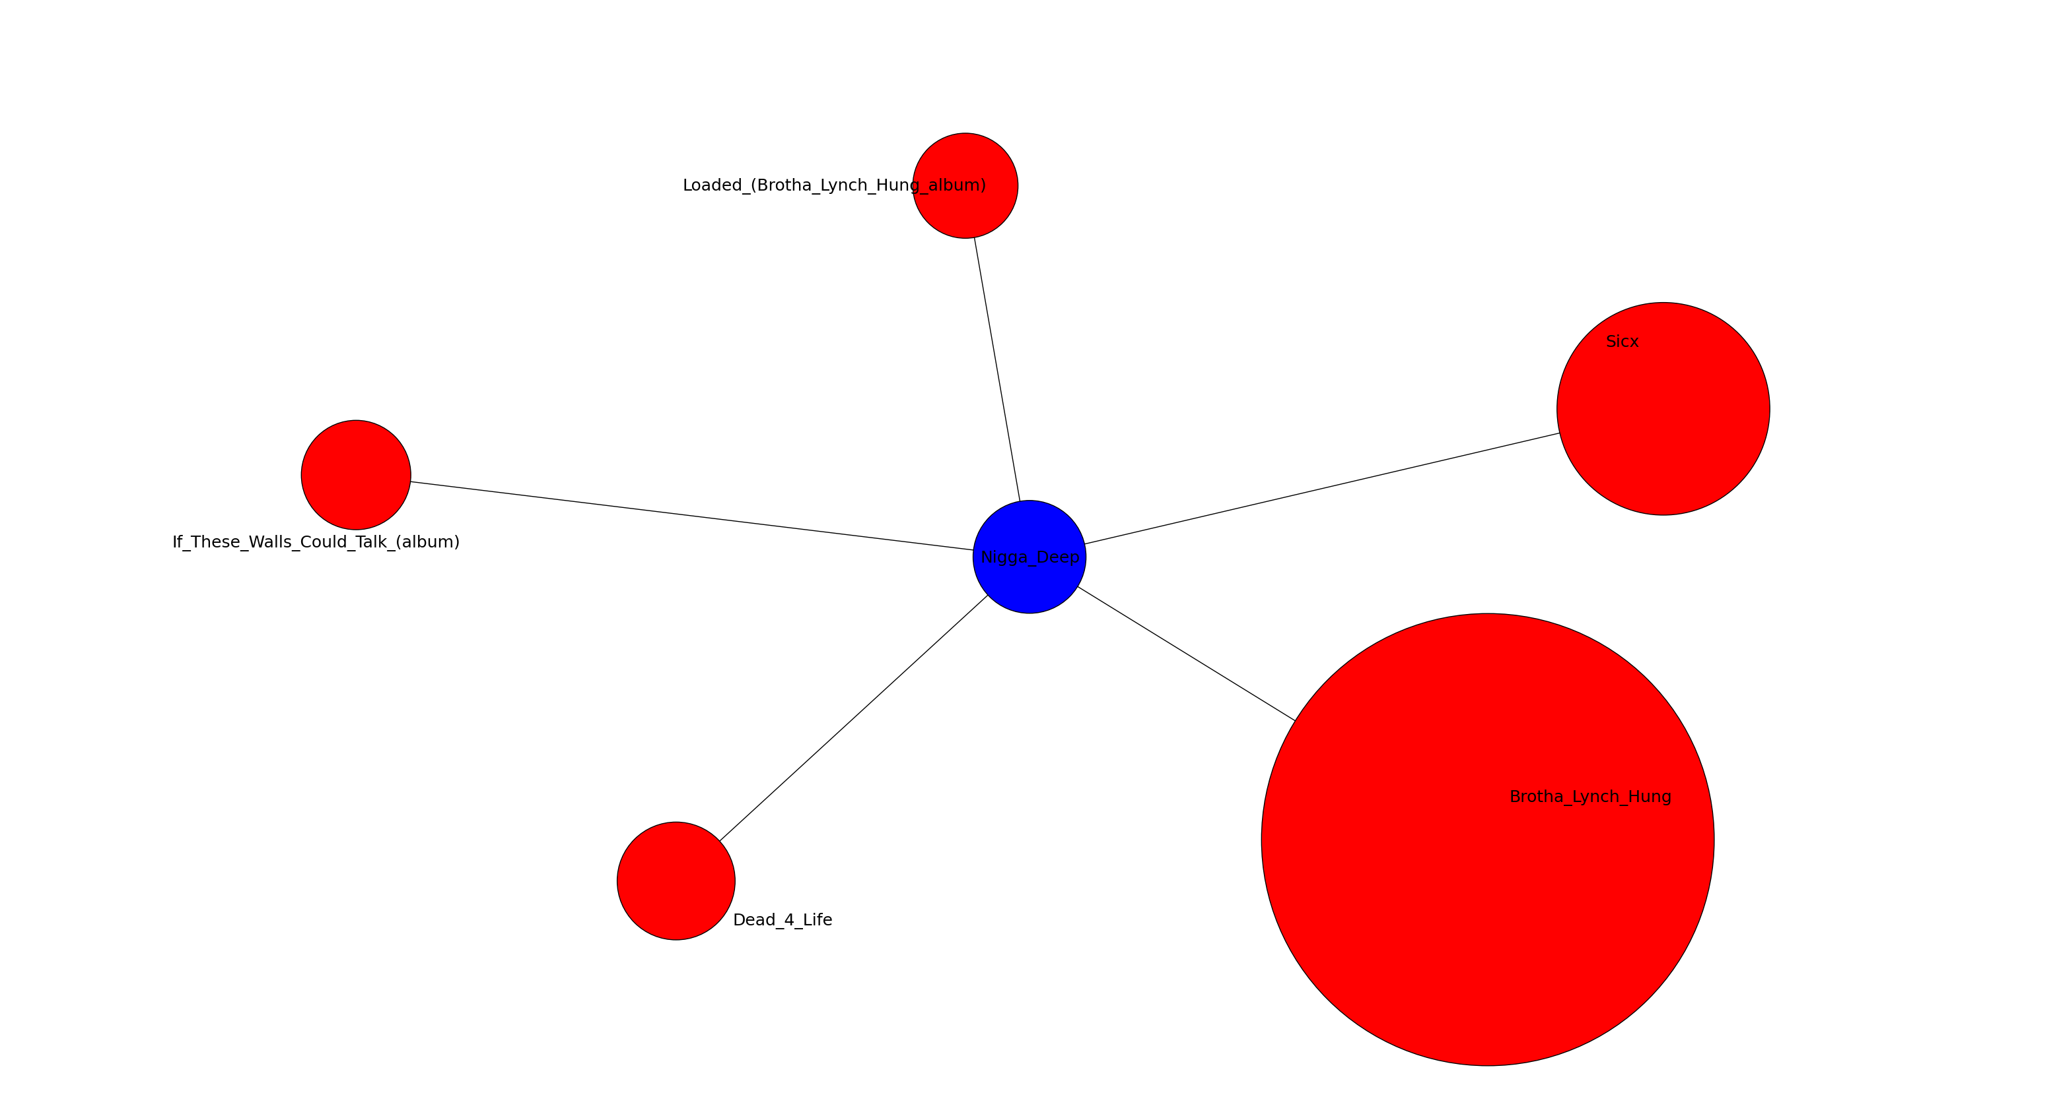
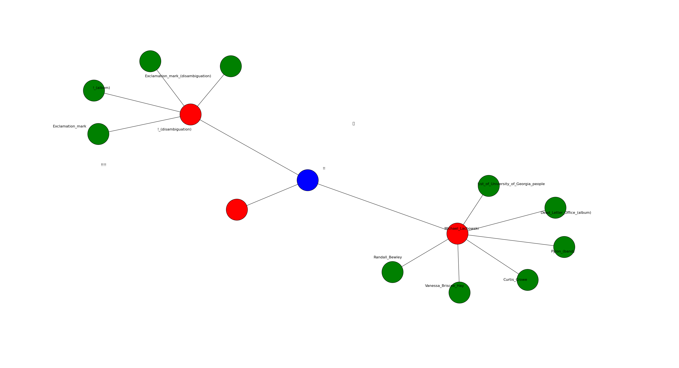
Hypothesis
We attempted to quantify the relationship between pages and inlinks to these pages.

Slide 5

Regression Model

Slide 6
Filtering and Reorganizing Data
Remove non-English Entries
2.5TB to 660GB
Via ad-hoc cluster: 20 instances running sed on data in the S3 bucket.
Remove English entries not included in titles-sorted.txt. And rearrange so that each entry includes the date.
Only done to a month’s worth of data
Giant hassle to do with whole dataset.
Via MRJob

Slide 7
MRJob Files
First MRJob function (“Step 1”) removes all pages that cannot have inlinks (such as images), removes percent encoding from pagenames, and adds datetime to each entry
Resulted in 42.15G for October 2008
Second MRJob functions (“Step 2”) takes pages of interest and their associated inlinks, and yields the data corresponding to these pages over the dataset

Slide 8
Producing Data to Test our Hypothesis
Each file contains only a sample of pages, not all of them.
Hence, over the 744 hours in a month won’t see 744 observations of a given page.
Our regression model relies on comparing page observations to inlink observations in the same hour.
Hence, the more inlinks, the lower the number of “complete” observations we could obtain from a month’s worth of data.
So we focused on pages with 1-5 inlinks.

Slide 9
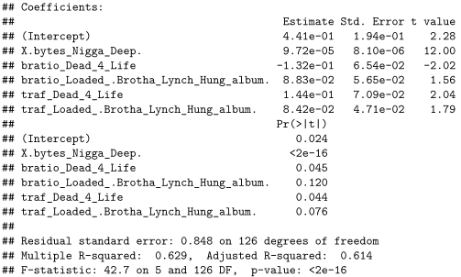
Results: Case Study

